Slide 1


استارتاپ‌ها چگونه با
ایــنــتــرنــت اشــیــا
شهر هوشمند خواهند ساخت؟

Slide 2

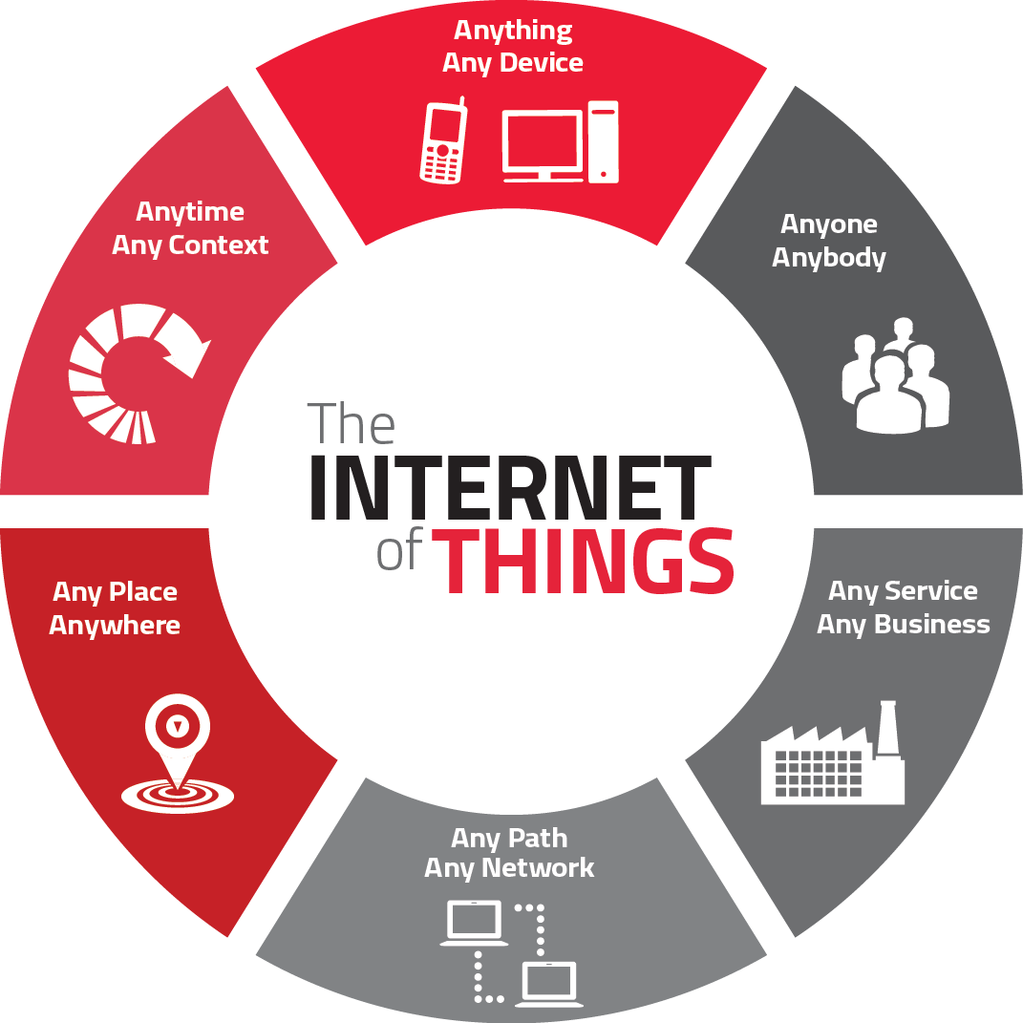

Slide 3
تا به امروز تلویزیون‌ها، خودروها، خانه‌ها، تجهیزات مختلف و اشیای بسیاری را داریم که به ایــنــتــرنــت متـــصـــل شده‌اند.

Slide 4
این اشـــیــا، می‌توانند سیستم‌ها را برای ما خودکار کرده، ارتباطات ما را تسهیل کنند و داده‌های مفیدی را برای ما جمع‌آوری نمایند.
Notes:
They can automate systems for us, allow us to communicate easier, and collect data for us.

Slide 5
از این رو، اگر تا به حال در این باره چیزی نشنیده باشید، باید بدانید که ایــــنـــتـــرنـــت اشـــیــــا به وقوع پیوسته است.

Slide 6
و حجم ارتباطات
ایــــنـــتـــرنـــت اشـــیــــا (IoT)
در حد انفجار است.

Slide 7
بیایید نگاهی به آمــــــــــــار بیندازیم...

Slide 8
کل ارتباطات
ایــنــتــرنــت اشــیــا
میلیارد
ما اینجاییم!
Source: Cisco.

Slide 9
فایده این همه اشـــیــــای به هم مــتــصــل چیست؟

Slide 10
ارزش این فــــنــــاوری احتمالا بسیار بیشتر از آن چیزی است که شما فکر می‌کنید.

Slide 11
حجم بازار اینترنت اشیا
(برمبنای تریلیون دلار)
Source: IDC.

Slide 12
حجم بالقوه این بازار بسیار بالاست. چون مهمترین کارکرد ایــنــتــرنــت اشــیــا افزایش کارایی در کنار کاربردهای نوین است.

Slide 13
این فــنــاوری‌هــا تقریبا در تمام عرصه‌های زندگی روزانه ما رسوخ خواهند کرد؛ بهداشت، حمل و نقل، آموزش، ابزارها و...

Slide 14
حتی بدبینانه‌ترین پیش‌بینی‌ها هم حاکی از تاثیر بسیار فراگیر ایــنــتــرنــت اشــیــا در آینده‌ای نزدیک بر زندگی ما دارد.

Slide 15
و ما تازه شروع کرده‌ایم...

Slide 16






ایــنــتــرنــت اشــیــا
مزایای بسیار زیادی برای انسان‌ها خواهــــد داشت.

Slide 17
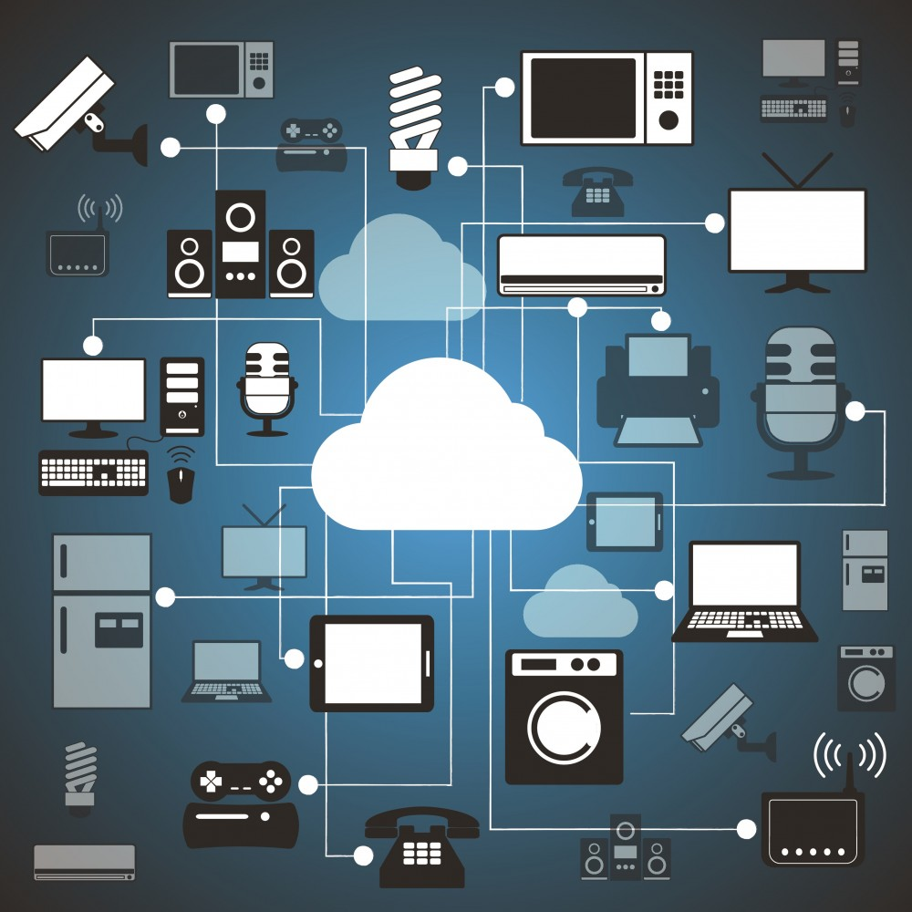
ما خواهیم توانست...
ماشین‌ها، خانه‌ها، ابزارهای پوشیدنی و...
را از طریق اینترنت به هم متصل کنیم.

Slide 18
ما خواهیم توانست...
ماشین‌ها، خانه‌ها، ابزارهای پوشیدنی و...
را از طریق اینترنت به هم متصل کنیم.
تا بسیاری از کارهای‌مان به صورت خودکار انجام شده
و ثبت داده‌های ضروری تسهیل شود.

Slide 19
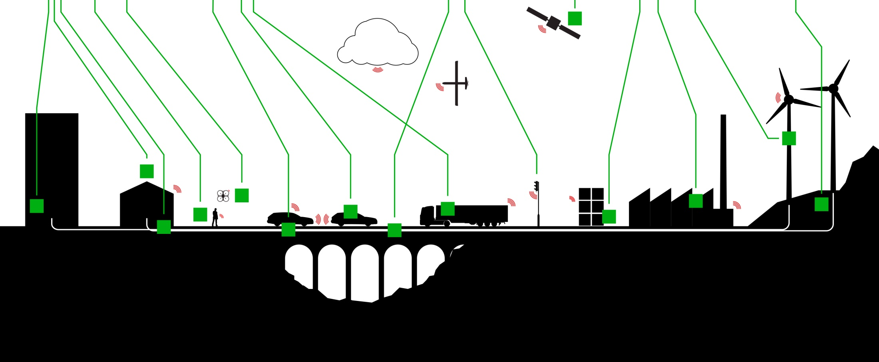
ولی این تنها مشتریان و مردم عادی نیستند که از
ایــنــتــرنــت اشــیــا
ســـــــــــــــــــــــود خواهند بـــــرد....

Slide 20
با استفاده از
ایــنــتــرنــت اشــیــا
مزایا و امکانات جدید بسیاری در انتظار
شرکت‌ها و کسب و کارهاست

Slide 21
اینترنت اشیا
صنایعی که در حال سرمایه‌گذاری روی حسگرهای اینترنت اشیا برای کسب و کارهای خود هستند.
Source: PricewaterhouseCoopers.

Slide 22
صرفه‌جویی حاصل از کارایی اینترنت صنعتی
(میلیارد دلار)
Source: GE.

Slide 23

جنرال الکتریک می‌گوید این صرفه‌جویی ناشی از فناوری‌های مورد استفاده برای بهبود موارد زیر است:
افزایش قابلیت اطمینان
تدام کارایی،
امنیت و اجرای بهتر دارایی‌ها

Slide 24
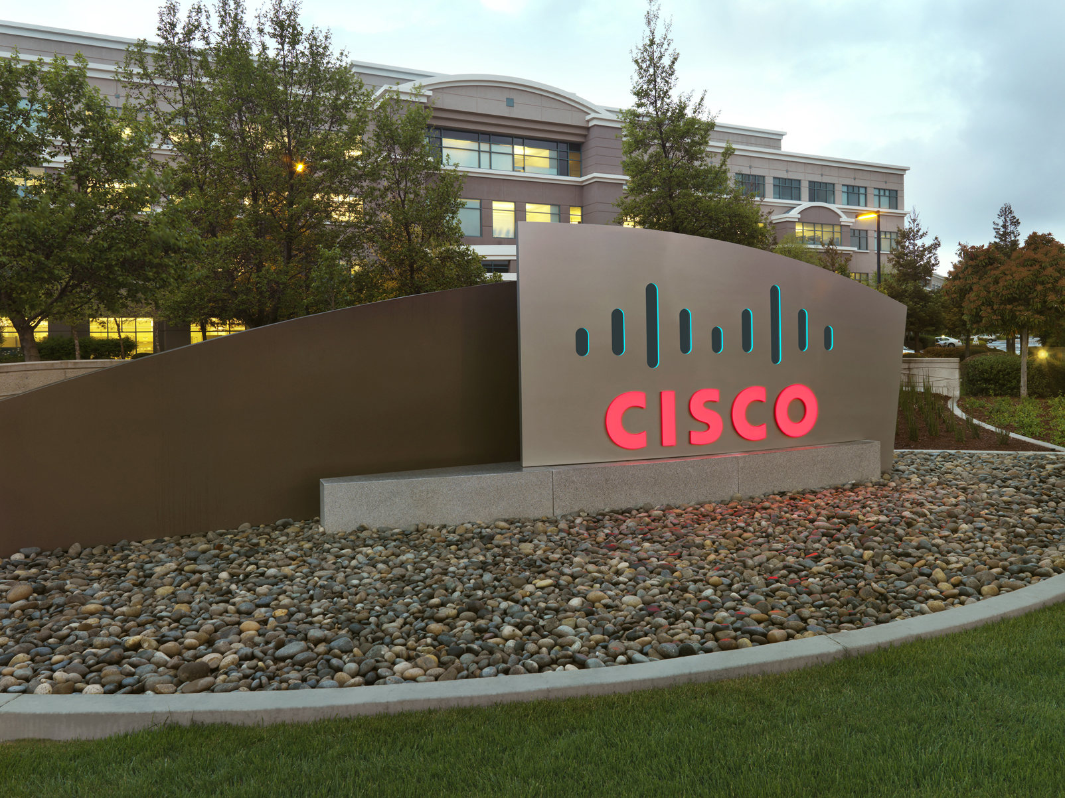
و سیسکو نیز موافق چنین تاثیری است. این شرکت می‌گوید یکی از محرک‌های کلیدی برای توسعه اینترنت اشیا
کاهش هزینه‌هاست.
اینترنت اشیا

Slide 25
19
تریلیون دلار
سیسکو تخمین می‌زند در یک دهه آینده حدود 19 تریلیون دلار از فواید اینترنت اشیا و کاهش هزینه‌های ناشی از استفاده این فناوری‌ها در صنایع مختلف عاید خواهد شد.
اینترنت اشیا

Slide 26

این در حالی است که متاسفانه
73%
شرکت‌ها هیچ سرمایه‌گذاری در حوزه اینترنت اشیا انجام نداده‌اند.
(در آمریکا)

Slide 27


61
برنامه کاربردی مبتنی بر
اینتـــرنت اشـــیا در یک
زندگی هوشمند

Slide 28
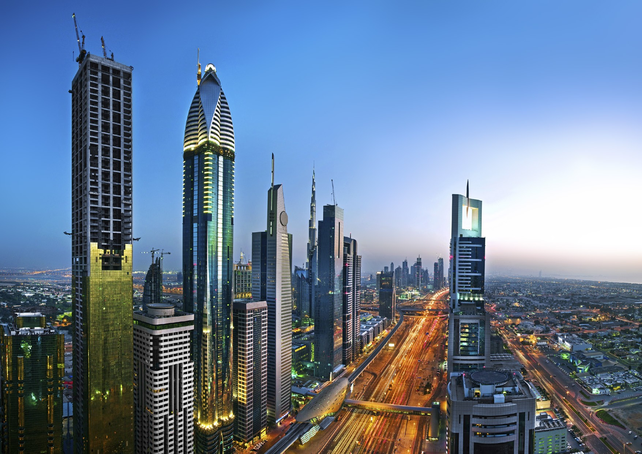
SMART CITIES
01
02
03
04
05
06
07
Smart Parking
Monitoring of parking spaces availability in
the city.
Structural health
Monitoring of vibrations and material conditions
in buildings, bridges and historical monuments.
Noise Urban Maps
Sound monitoring in bar areas and centric zones
in real time.
Smartphones Detection
Detect iPhone and Android devices and in general
any device which works with Wifi or Bluetooth
interfaces.
Eletromagnetic Field Levels
Measurement of the energy radiated by cell
stations and and WiFi routers.
Traffic Congestion
Monitoring of vehicles and pedestrian levels to
optimize driving and walking routes.
Smart City technology investment will total $108 billion by 2020.
Pike Research
Smart Lighting
Intelligent and weather adaptive lighting in
street lights.

Slide 29
SMART CITIES
08
09
Waste management
Detection of rubbish levels in containers to
optimize the trash collection routes.
Smart Roads
Intelligent Highways with warning messages and
diversions according to climate conditions and
unexpected events like accidents or traffic jams.
Smart City technology investment will total $108 billion by 2020.
Pike Research

Slide 30

SMART ENVIRONMENT
10
11
12
13
14
Forest Fire Detection
Monitoring of combustion gases and preemptive
fire conditions to define alert zones.
Air Pollution
Control of CO₂ emissions of factories, pollution
emitted by cars and toxic gases generated in farms.
Snow Level Monitoring
Snow level measurement to know in real time
the quality of ski tracks and allow security corps
avalanche prevention.
Earthquake Early Detection
Distributed control in specific places of tremors.
Landslide and Avalanche Prevention
Monitoring of soil moisture, vibrations and earth
density to detect dangerous patterns in land
conditions.
More than 100,000 wildfires clear 4 million to 5 million acres (1.6 - 2 million ha) of land only in the USA.

Slide 31

SMART WATER
15
16
17
18
19
20
Portable water monitoring
Monitor the quality of tap water in cities.
Chemical leakage detection in rivers
Detect leakages and wastes of factories in rivers.
Swimming pool remote measurement
Control remotely the swimming pool conditions.
Pollution levels in the sea
Control realtime leakages and wastes in the sea.
Water Leakages
Detection of liquid presence outside tanks and
pressure variations along pipes.
River Floods
Monitoring of water level variations in rivers,
dams and reservoirs.
Today, the worldwide water consumption is 300% compared to 1950.

Slide 32
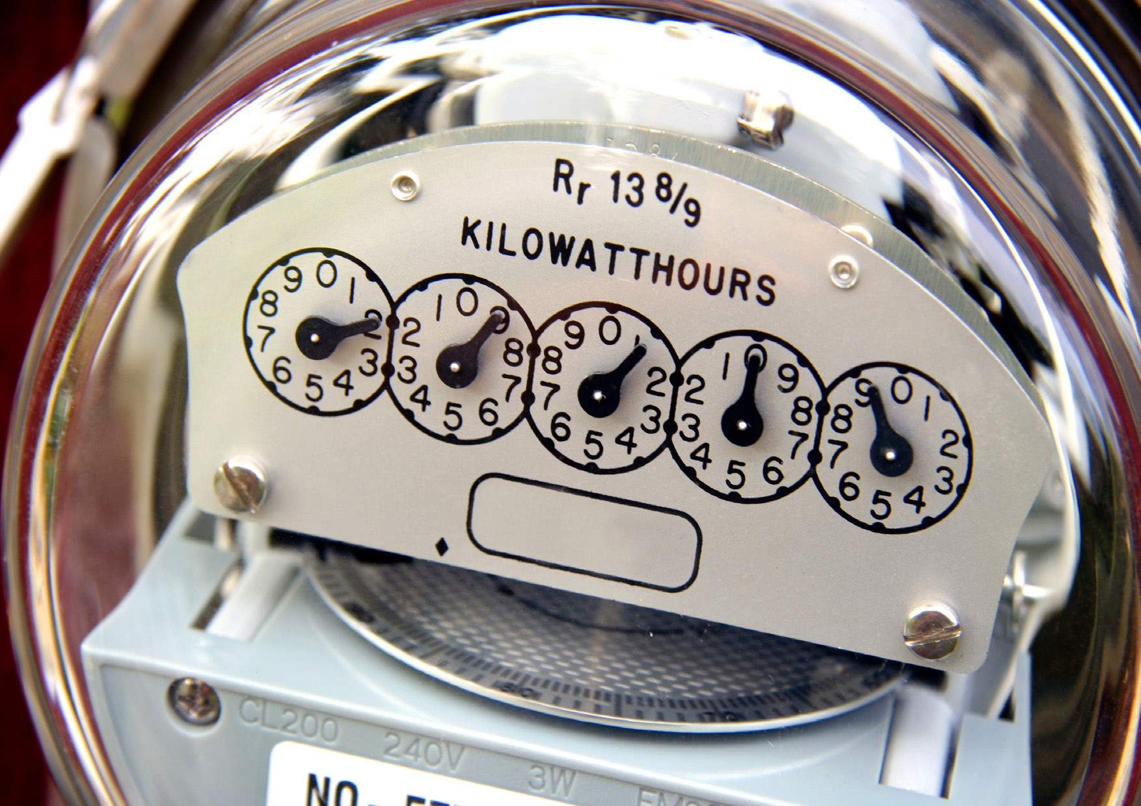
SMART METERING
21
22
23
24
25
Smart Grid
Energy consumption monitoring and management.
Tank Level
Monitoring of water, oil and gas levels in storage
tanks and cisterns.
Photovoltaic Installations
Monitoring and optimization of performance in
solar energy plants.
Water Flow
Measurement of water pressure in water
transportation systems.
Silos Stock Calculation
Measurement of emptiness level and weight of
the goods.
European Union mandates that 100% of European households have smart metering capabilities by 2022.

Slide 33
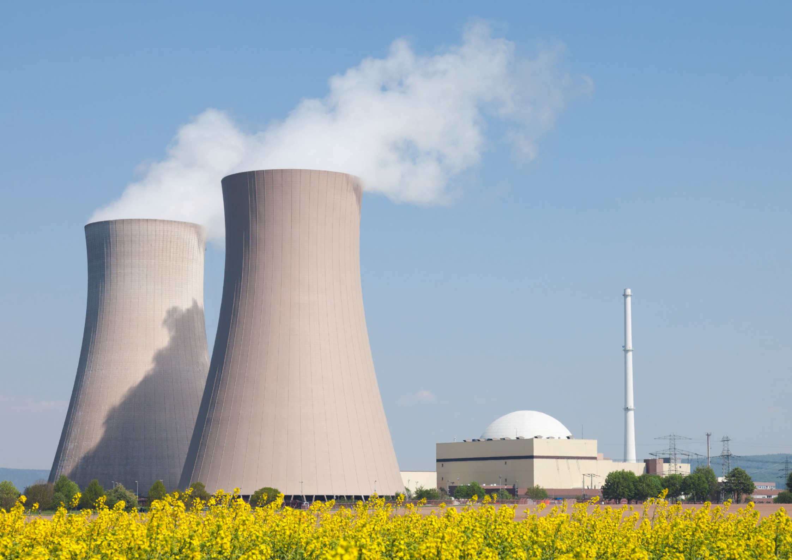
SECURITY &
EMERGENCIES
26
27
28
29
Perimeter Access Control
Access control to restricted areas and detection
of people in non-authorized areas.
Liquid Presence
Liquid detection in data centers, warehouses and
sensitive building grounds to prevent break downs
and corrosion.
Radiation Levels
Distributed measurement of radiation levels in
nuclear power stations surroundings to generate
leakage alerts.
Explosive and Hazardous Gases
Detection of gas levels and leakages in industrial
environments, surroundings of chemical factories
and inside mines.
Nuclear energy covers 16% of the planet energy needs.

Slide 34

RETAIL
30
31
32
33
Supply Chain Control
Monitoring of storage conditions along the supply chain and product tracking for traceability purposes.
NFC Payment
Payment processing based in location or activity duration for public transport, gyms, theme parks, etc.
Intelligent Shopping Application
Getting advices in the point of sale according to customer habits, preferences, presence of allergic components for them or expiring dates.
Smart Product Management
Control of rotation of products in shelves and warehouses to automate restocking processes.
Failure to restock supermarket shelves costs the FMCG industry 4 billion € each year.
ECR Europe

Slide 35
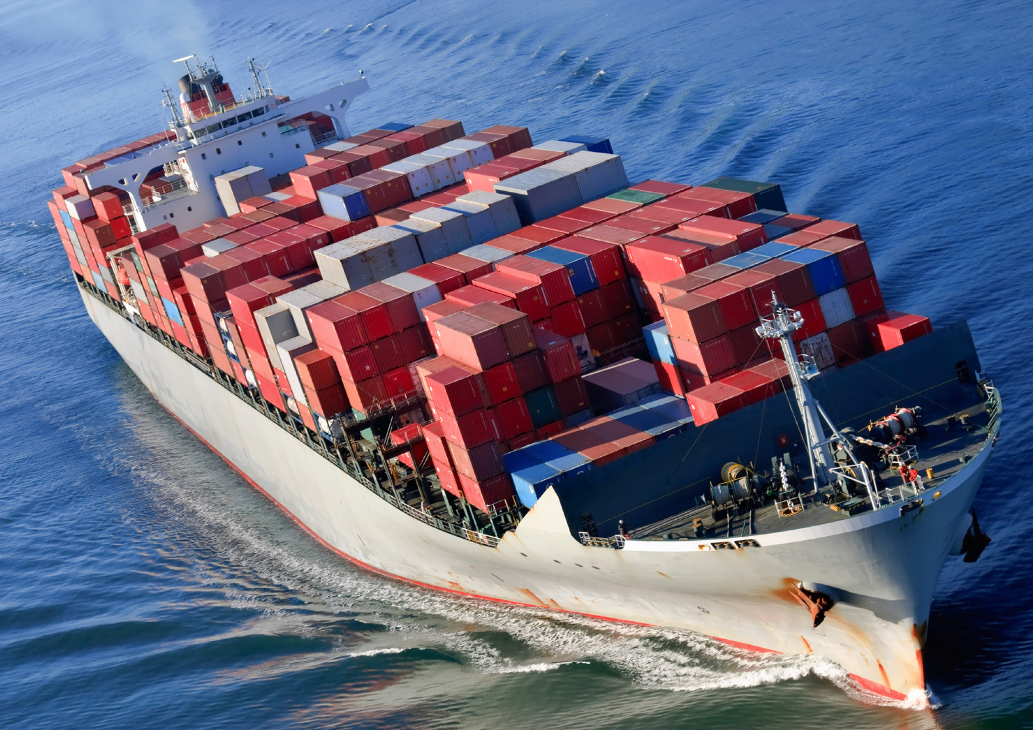
LOGISTICS
34
35
36
37
Quality of Shipment Conditions
Monitoring of vibrations, strokes, container
openings or cold chain maintenance for insurance
purposes.
Item Location
Search of individual items in big surfaces like
warehouses or harbours.
Storage Incompatibility Detection
Warning emission on containers storing
inflammable goods closed to others containing
explosive material.
Fleet Tracking
Control of routes followed for delicate goods
like medical drugs, jewels or dangerous
merchandises.
Each year, more than 100 million shipping containers travel around the globe.

Slide 36
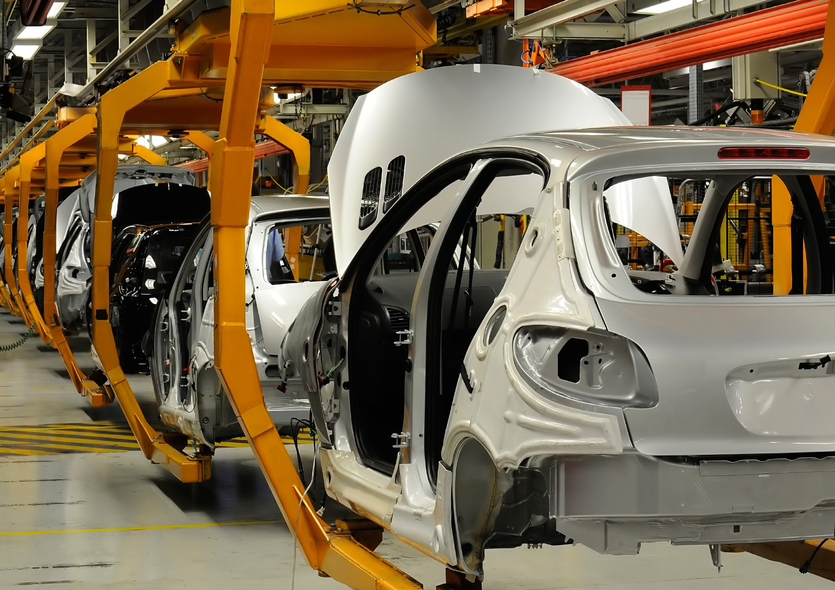
INDUSTRIAL CONTROL
38
39
40
41
42
43
M2M Applications
Machine auto-diagnosis and assets control.
Indoor Air Quality
Monitoring of toxic gas and oxygen levels
inside chemical plants to ensure workers and
goods safety.
Temperature Monitoring
Control of temperature inside industrial and
medical fridges with sensitive merchandise.
Ozone Presence
Monitoring of ozone levels during the drying meat
process in food factories.
Indoor Location
Asset indoor location by using active (ZigBee) and
passive tags (RFID/NFC).
Vehicle Auto-diagnosis
Information collection from CanBus to send real
time alarms to emergencies or provide advice
The volume of cellular M2M subscriptions is expected to increase fourfold between 2010 and 2016.
Pyramid Research
to drivers.

Slide 37
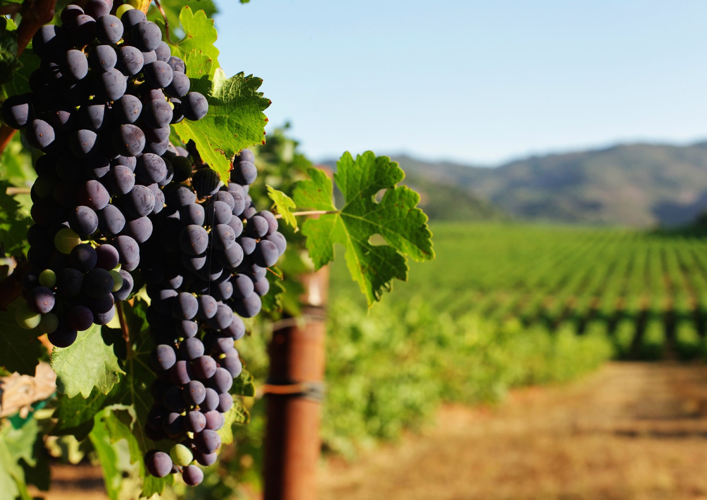
SMART AGRICULTURE
44
45
46
47
48
49
Wine Quality Enhancing
Monitoring soil moisture and trunk diameter in
vineyards to control the amount of sugar in grapes
and grapevine health.
Green Houses
Control micro-climate conditions to maximize the
production of fruits and vegetables and its quality.
Golf Courses
Selective irrigation in dry zones to reduce the
water resources required in the green.
Meteorological Station Network
Study of weather conditions in fields to forecast ice
formation, rain, drought, snow or wind changes.
Compost
Control of humidity and temperature levels in
alfalfa, hay, straw, etc. to prevent fungus and
other microbial contaminants.
Hydroponics
Control the exact conditions of plants grown in
water to get the highest efficiency crops.
The 60% of water is needed in irrigation, and 20-30% out of this figure is wasted due to
evaporation and over-watering.

Slide 38
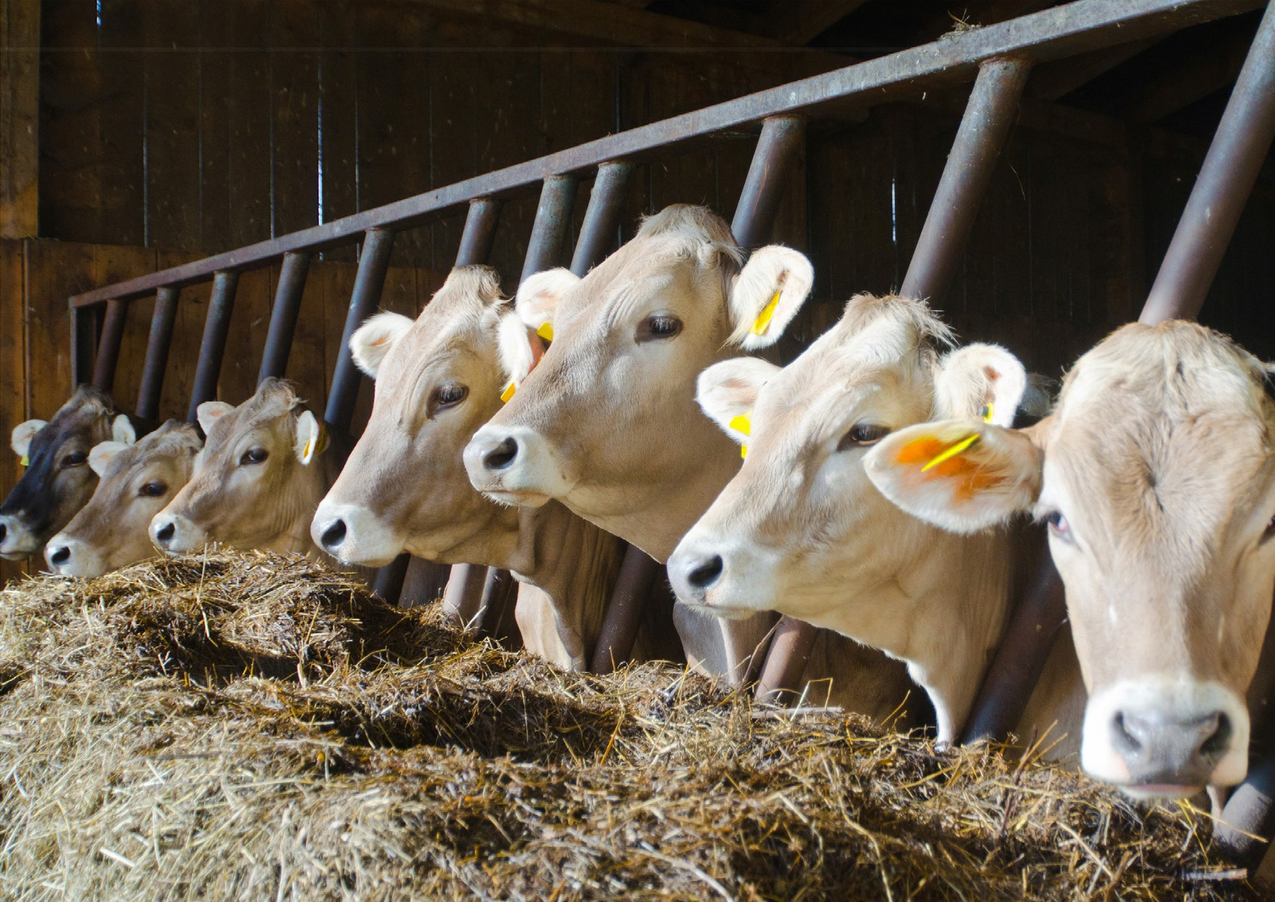
SMART
ANIMAL FARMING
50
51
52
Offspring Care
Control of growing conditions of the offspring in
animal farms to ensure its survival and health.
Animal Tracking
Location and identification of animals grazing in
open pastures or location in big stables.
Toxic Gas Levels
Study of ventilation and air quality in farms and
detection of harmful gases from excrements.
The CH₄ emissions from animal farming in the U.S. have increased a 17% during the past decade.
U. S. Environmental Protection Agency

Slide 39

DOMOTIC &
HOME AUTOMATION
53
54
55
56
Energy and Water Use
Energy and water supply consumption monitoring
to obtain advice on how to save cost and resources.
Remote Control Appliances
Switching on and off remotely appliances to avoid
accidents and save energy.
Intrusion Detection Systems
Detection of windows and doors openings and
violations to prevent intruders.
Art and Goods Preservation
Monitoring of conditions inside museums and art
warehouses.
European Union homes should cut energy consumption by 20% by 2020 according to Kyoto Protocol.

Slide 40

eHEALTH
57
58
59
60
61
Fall Detection
Assistance for elderly or disabled people living independent.
Medical Fridges
Control of conditions inside freezers storing vaccines, medicines and organic elements.
Sportsmen Care
Vital signs monitoring in high performance centers and fields.
Patients Surveillance
Monitoring of conditions of patients inside hospitals and in old people’s home.
Ultraviolet Radiation
Measurement of UV sun rays to warn people not to be exposed in certain hours.
65+ people will go from 7% to 12% by 2030.

Slide 41
slideshare.net/mahdinasseri

